Slide 1




THEORY OF AUTOMATA
Information available in audio.
PROJECT PROPOSAL PRESENTATION
PRESENTED BY
Maheen Aslam
Qainat naeem
Zainab
PRESENTED TO
SIR Rana Marwat
3-Jann 2024

Slide 2



Add Company Name
How to class Define
c++
1CLASS STUDENT {
STRING NAME;
INT CONTACT NO;
};
user friendly syntax
FILE STUDENT{
ALPHABET NAME;
DIGIT CONTACTNO;
};
adapted c++ syntax than make most user friendly syntax .
Back to Agenda

Slide 3

TOC
MOTIVES
Custom Language Creation:
Developing a unique programming language with self-defined rules.
Innovative Conditional Statements:
Clear formal definitions and production rules for custom conditional statements.
Back to Agenda

Slide 4
TOC
MOTIVES
C++ Base Utilization:
Adaptation of C++ as the foundational language for implementing custom rules.
Datatype Replacement:
Replacement of conventional datatypes with descriptive terms (e.g., 'alphabet' for 'string,' 'digit data type' for 'int').
Back to Agenda

Slide 5

Add Company Name
Conditional statement
kids easily understand how to work if else satement
Syntax :
Back to Agenda

Slide 6
Add Company Name
Proposed Timeline
2022
2023
2024
2025
Briefly elaborate on what you want to discuss.
Write a
project or milestone here.
Write a
project or milestone here.
Write a
project or milestone here.
Write a
project or milestone here.
Back to Agenda

Slide 7
Add Company Name
For inquiries, contact us.
EMAIL
SOCIAL MEDIA
CALL US
hello@reallygreatsite.com
@reallygreatsite
123-456-7890

Slide 8
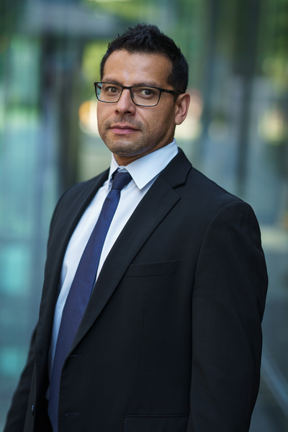




Collaborate on a Whiteboard
Write a note here
Write a note here
Tip: Collaboration makes teamwork easier! Click "Share" and invite your teammates to fill this up. Use this page for bulletins, brainstorms, and other fun team ideas.
Right-click on the background of the slide, or on the thumbnail below, for the option to expand this page into a whiteboard for more space!
Copy a note, drag to the board, and write your ideas.
Copy a note, drag to the board, and write your ideas.

Slide 9
Collaborate on a Whiteboard
Add even more sub-ideas
Add more sub-ideas
Add more sub-ideas
Add even more sub-ideas
Add a related idea
ADD A
MAIN TOPIC
Add a related idea
Add a related idea
Add a related idea
Add even more sub-ideas
Tip: Collaboration makes teamwork easier! Click "Share" and invite your teammates to fill this up. Use this page for bulletins, brainstorms, and other fun team ideas.
Right-click on the background of the slide, or on the thumbnail below, for the option to expand this page into a whiteboard for more space!
Add more sub-ideas
Add more sub-ideas
Add even more sub-ideas

Slide 10






Resource Page
Use these design resources in
your Canva Presentation.
Happy designing!
Delete or hide this page
before presenting.

Slide 11




















Resource Page
Use these design resources in
your Canva Presentation.
Happy designing!
Delete or hide this page
before presenting.

Slide 12
B
C
for confetti
Resource Page
for blur
D
M
for mic drop
for a drumroll
Find the magic and fun in presenting with Canva Presentations. Press the following keys while on Present mode!
Delete or hide this page
before presenting.
O
Q
for quiet
for bubbles
U
#
Any number from 0-9
for a timer
for unveil

Slide 13
1 | Click the Share button on the top right corner of your screen and select 'Present and Record.'
2 | Click ‘Go to recording studio,’ where you can choose the video and audio source for your video presentation.
3 | Feel free to choose the ‘No camera’ option and record your voice only.
4 | Start recording, and press pause in between takes if you have to.
5 | Once you're done, download your Canva Presentation in MP4 file format or get a link to your Talking Presentation and share it with others.
6 | You can also record a video inside the editor! Go to 'Uploads' and click on 'Record yourself'.
Resource Page
Presenting live not your thing? No worries! Record your Canva Presentation your audience can watch at their own pace.
Don't forget to delete or hide this page before presenting.

